Slide 2
FILE SYSTEM

Slide 3
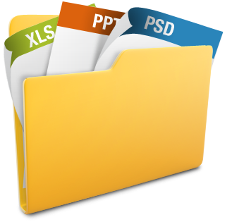
File
A file is a collection of related info defined by its creator.
In general, file is a sequence of bits, bytes, lines or records.
Some examples of file types :
Text file – sequence of characters organized into lines.
Source file – sequence of subroutines or functions.
Object file – collection of words, organized into loader record blocks.

Slide 4
File Parameters
JustForFun
123
Txt
1024 KB
Read-only
Used to keep track of file in OS.
Name – human readable form
Identifier – unique ID (gen. numers)
Type – file type
Location – pointer to a device & location of file on the device
Size – current size
Protection – Access control Info
Time & Date – Creation, modification,deletion
User ID – user identification

Slide 5
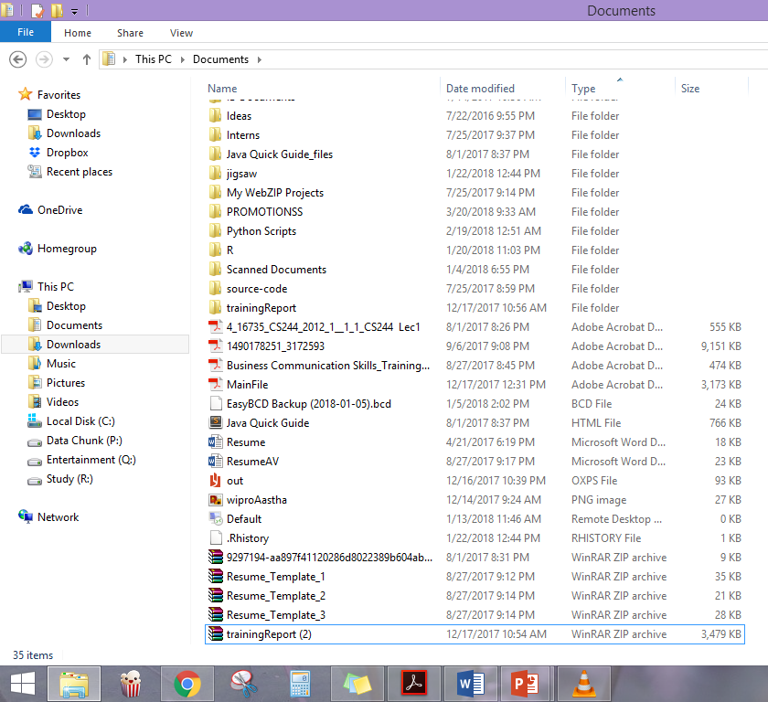
Files vs. Folders

Slide 6

FILE ATTRIBUTES
File attributes are settings associated with computer files that grant or deny certain rights to how a user or the operating system can access that file.
Read only
Hidden
System
Archive

Slide 7
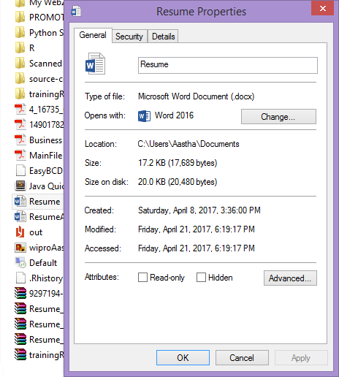
1. Read only (R)
Allows a file to be read, but nothing can be written to the file or changed.
When set, indicates that a file should not be altered. Upon opening the file, file system API usually does not grant write permission to the requesting application, unless the application explicitly requests it. Read-only attributes on folders are usually ignored, being used for another purpose.

Slide 8
2. Hidden (H)
File will not be shown when doing a regular dir from DOS.
When set, indicates that the hosting file is hidden. Windows apps like File Explorer do not show hidden files by default, unless asked to do so.

Slide 9

3. System (S)
System file.
When set, indicates that the hosting file is a critical system file that is necessary for the computer to operate properly.
Microsoft Windows use it to mark important system files.
Windows apps like File Explorer do not show system files by default even when hidden files are shown, unless asked to do so.

Slide 10
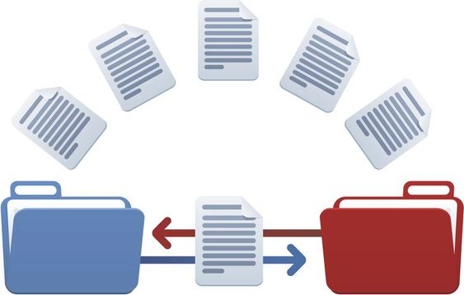
4. Archive File (A)
Tells Windows Backup to backup the file.
When set, it indicates that the hosting file has changed since the last backup operation. Windows' file system sets this attribute on any file that has changed. Backup software then has the duty of clearing it upon a successful backup.

Slide 11
More Attributes :
Compressed (C) – When set, Windows compresses the hosting file upon storage
Encrypted (E) – When set, Windows encrypts the hosting file upon storage to prevent unauthorized access.
Not Content-Indexed (I) – When set, Indexing Service or Windows Search do not include the hosting file in their indexing operation.
Directory (D) – The entry is a subdirectory, containing file and directory entries of its own.
Not Indexed (N) –The file is not indexed on the host device.
Offline (O) – The file data is physically moved to offline storage (Remote Storage).
Sparse (P) – The file is a sparse file, i.e., its contents are partially empty and non-contiguous.
Temporary (T) – The file is used for temporary storage.

Slide 12
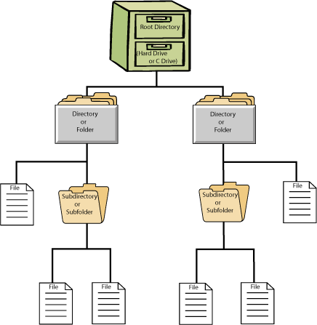
What is File system?
In computing, a file system controls how data is stored and retrieved.
The structure and logic rules used to manage the groups of information and their names is called a "file system".
Without a file system, information placed in a storage medium would be one large body of data with no way to tell where one piece of information stops and the next begins.

Slide 13
What is File system?
In other words, it’s a mechanism to organize our data.
It has its own data structure to achieve desired organization.
It has its own algorithm to achieve desired performance.
Its the ability to store, retrieve, sort, search,…….

Slide 14
Types of File System
Disk File System
Optical Disks
Flash File System
Tape File System
Database File System
Network File System
Shared Disk File System
Special File System

Slide 15
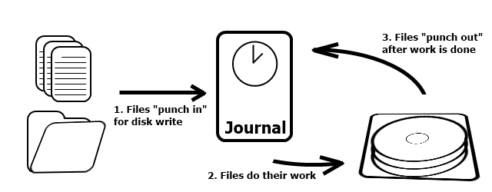
Disk File System
A disk file system takes advantages of the ability of disk storage media to randomly address data in a short amount of time.
Additional considerations include the speed of accessing data following that initially requested and the anticipation that the following data may also be requested.

Slide 16
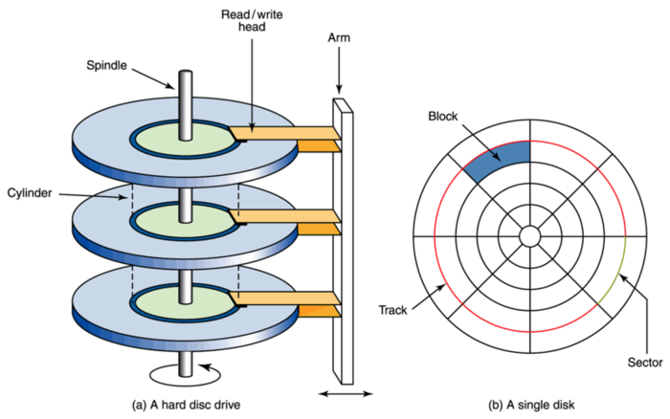
Disk File System

Slide 17
Disk File System
This system permits multiple users (or processes) access to various data on the disk without regard to the sequential location of the data.
Examples include :
FAT (FAT12, FAT16, FAT32), exFAT, NTFS, HFS and HFS+, HPFS, APFS, UFS, ext2, ext3, ext4, XFS, btrfs, ISO 9660, Files-11, Veritas File System, VMFS, ZFS, ReiserFS and UDF.

Slide 18
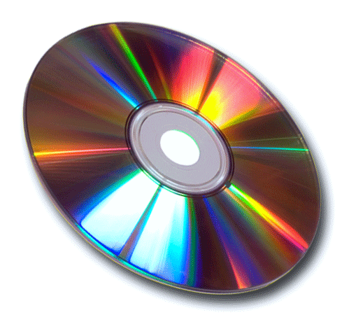
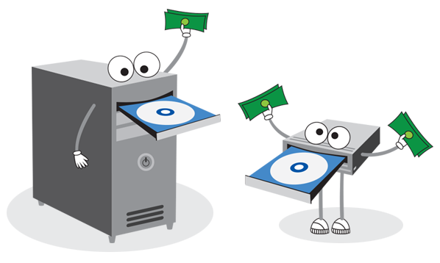
Optical Disks
ISO 9660 and Universal Disk Format (UDF) are two common formats that target Compact Discs, DVDs and Blu-ray discs.
Mount Rainier is an extension to UDF supported since 2.6 series of the Linux kernel and since Windows Vista that facilitates rewriting to DVDs.

Slide 19
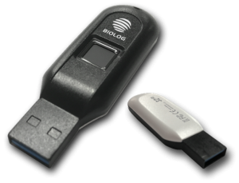
Flash File System
A flash file system is a file system designed for storing files on
flash memory–based storage devices.
While the flash file systems are closely related to file systems in general, they are optimized for the nature and characteristics of flash memory (such as to avoid write amplification), and for use in particular operating systems.
A flash file system considers the special abilities, performance and restrictions of flash memory devices.
Frequently a disk file system can use a flash memory device as the underlying storage media but it is much better to use a file system specifically designed for a flash device.

Slide 20


Tape File System
A tape file system is a file system and tape format designed to
store files on tape in a self-describing form.
Magnetic tapes are sequential storage media with significantly longer random data access times than disks, posing challenges to the creation and efficient management of a general-purpose file system.
Tape requires linear motion to wind and unwind potentially very long reels of media. This tape motion may take several seconds to several minutes to move the read/write head from one end of the tape to the other.
IBM has developed a file system for tape called the Linear Tape File System. The IBM implementation of this file system has been released as the open-source IBM Linear Tape File System — Single Drive Edition (LTFS-SDE) product.

Slide 21
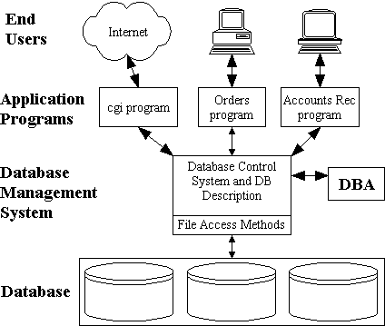
Database file systems
Another concept for file management is the idea of a database-based file system. Instead of, or in addition to, hierarchical structured management, files are identified by their characteristics, like type of file, topic, author, or similar rich metadata.
Around 1978 to 1988 Frank G. Soltis and his team at IBM Rochester have successfully designed and applied technologies like the database file system where others like Microsoft later failed to accomplish. These technologies are informally known as 'Fortress Rochester' and were in few basic aspects extended from early Mainframe technologies but in many ways more advanced from a technological perspective

Slide 22
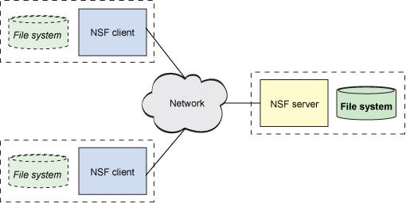
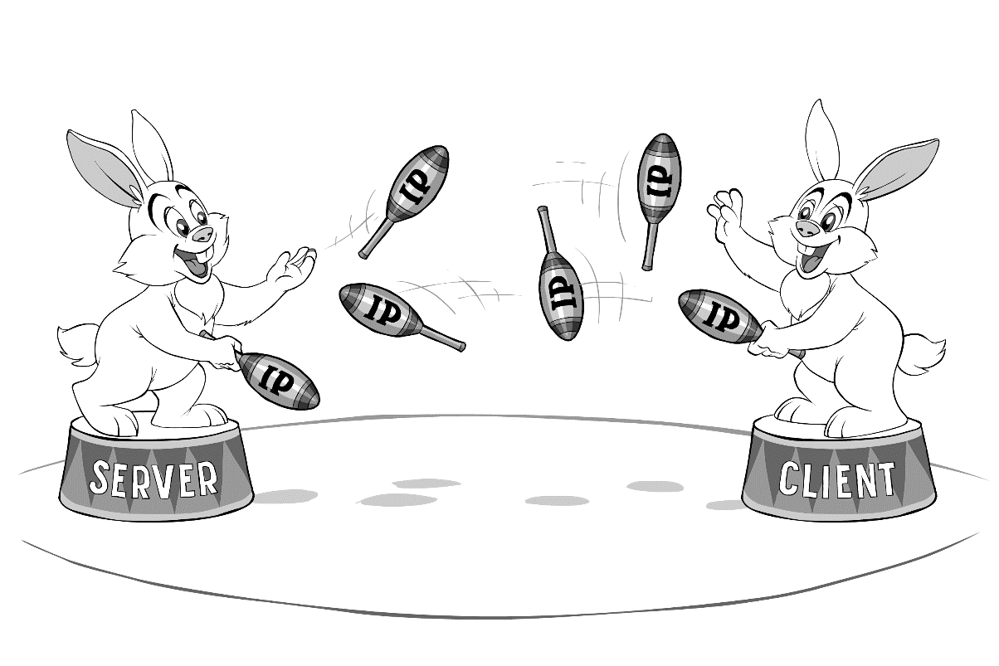
Network file systems
A network file system is a file system that acts as a client for a remote file access protocol, providing access to files on a server.
Programs using local interfaces can transparently create, manage and access hierarchical directories and files in remote network-connected computers.
Examples of network file systems include clients for the NFS, AFS, SMBprotocols, and file-system-like clients for FTP and WebDAV.

Slide 23
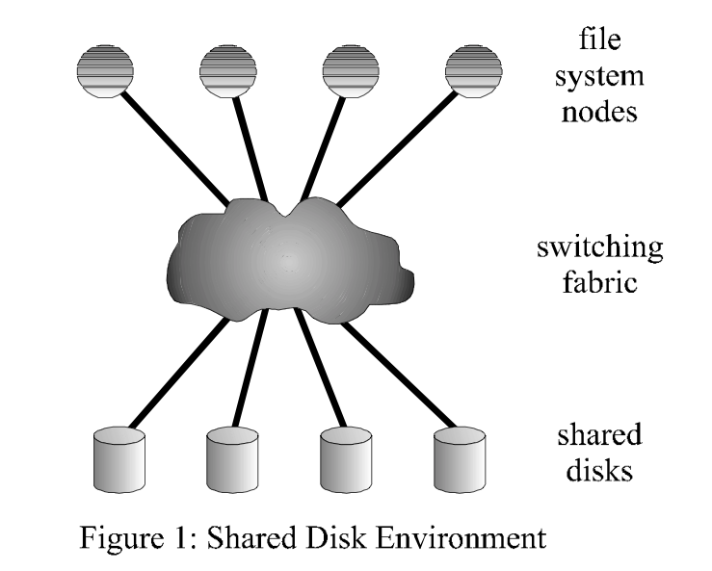
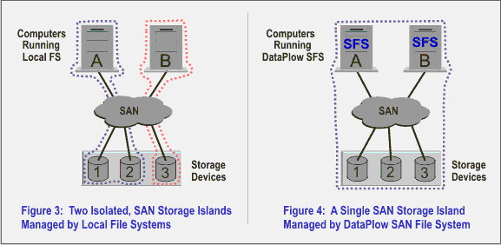
Shared disk file systems
A shared disk file system is one in which a number of machines (usually servers) all have access to the same external disk subsystem (usually a SAN). The file system arbitrates access to that subsystem, preventing write collisions.
Examples include GFS2from Red Hat, GPFS from IBM, SFS from DataPlow, CXFS from SGI and StorNext from Quantum Corporation.

Slide 24

Special file systems
A special file system presents non-file elements of an operating system as files so they can be acted on using file system APIs.
This is most commonly done in Unix-like operating systems, but devices are given file names in some non-Unix-like operating systems as well.

Slide 25
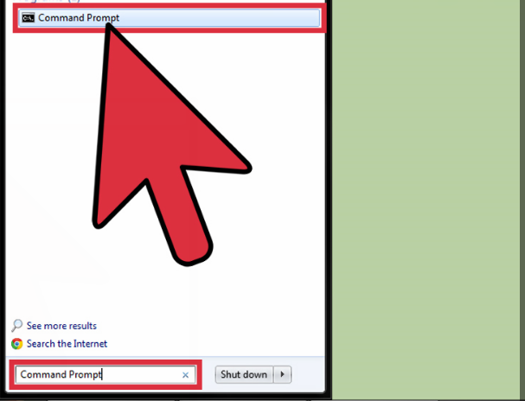
Creating files and directories
Using cmd prompt >>
1. Open the Windows Command Prompt :
Click on the start screen of your computer and go to the search box. Type command prompt or cmd. Double click on Command Prompt from the list of results to open the command prompt.
The command prompt will look like this c:\users\username

Slide 26
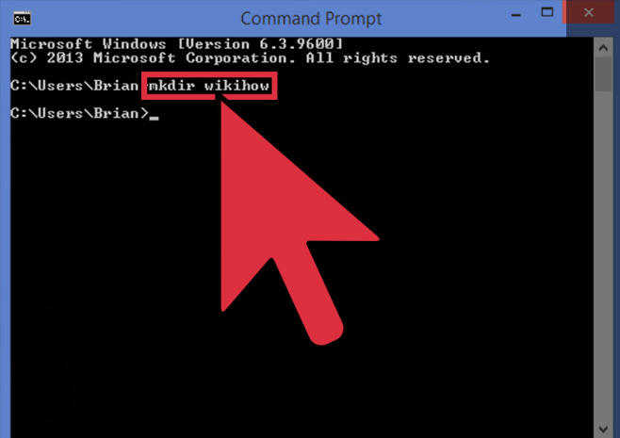
1. Creating directories
Use the mkdir command to create a new directory to work with.
The command is mkdir directory name.
In the example above, a new directory called wikihow was created by typing : mkdir wikihow.

Slide 27
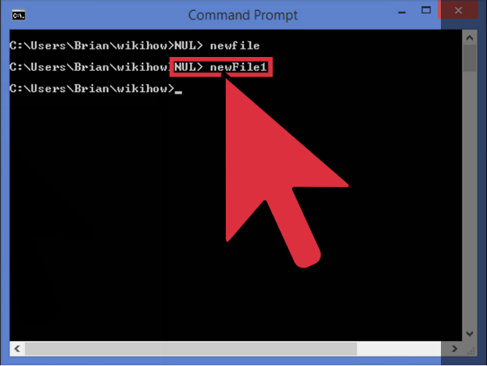
2. Creating files
In order to create a new file, use the type NUL > command.
Type: type NUL> filename and press enter to create a new empty file.
In the example above, type NUL> newFile1 was typed.

Slide 28
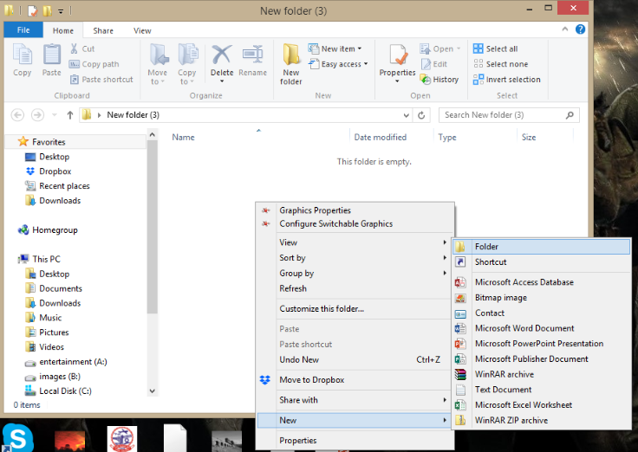
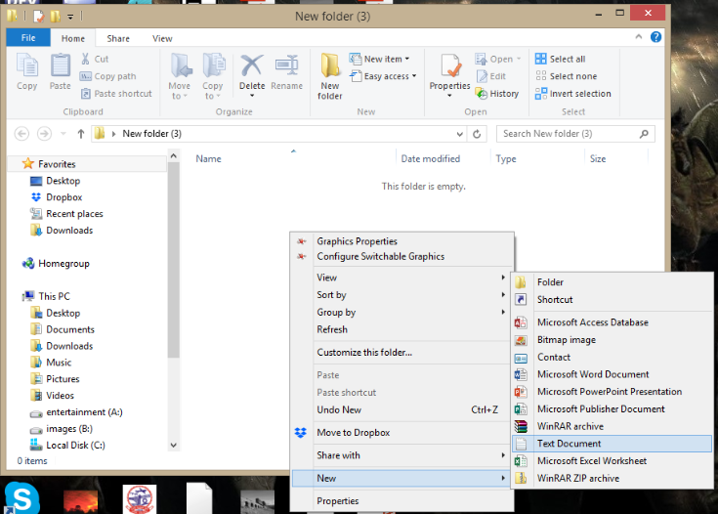
Creating files and directories (using GUI)
To make a directory -- right-click and select New Folder.
To make a file -- right-click and select
New Document -> Text Document.

Slide 29
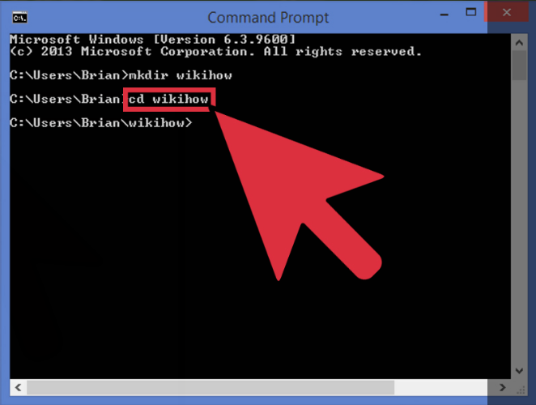
Opening Directories
Opening current working directory.
In order to move into the newly created directory, use the cd or change directory command.
The command is cd -> directory name.
In the example, cd wikihow was typed. Now the prompt looks like this: C:\users\Brian\wikihow>

Slide 30
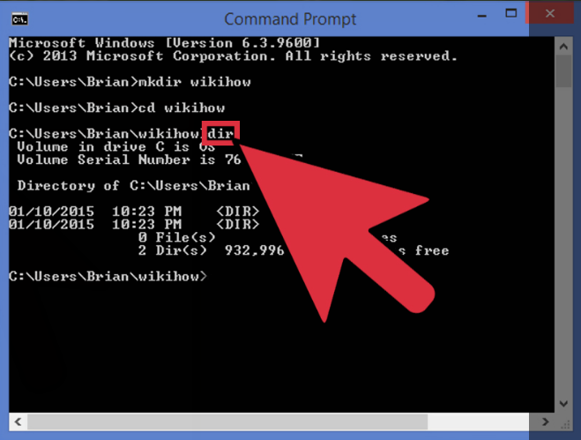
Reading Directories
Reading the directory contents.
In order to check the contents of the current directory, use the dir command.
Simply type dir and press enter and a list of the directory contents will be displayed as shown.

Slide 31

WINDOWS File System
In the early days of computing, Microsoft developed a file system, in collaboration with IBM ,which was named as FAT file system.
FAT file system was developed to meet the requirements of storage devices at that time, which used to be very limited in size.
Later on as the size of storage devices grew, FAT file system encountered many problems, so NTFS came into existence.

Slide 32

FAT (File Allocation Table)
FAT is by far the most simplistic of the file systems supported by Windows OS. The family of FAT file systems is supported by almost all operating systems for personal computers, including all versions of Windows and MS-DOS (FAT was used in MS-DOS and early versions of Windows such as 95 and 98).
The FAT file system is characterized by the file allocation table (FAT), which is really a table of content that resides at the very "top" of the volume.
To protect the volume, two copies of the FAT are kept in case one becomes damaged. In addition, the FAT tables and the root directory must be stored in a fixed location so that the system's boot files can be correctly located.

Slide 33
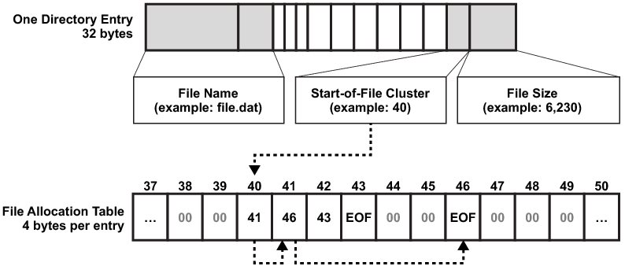
FAT (File Allocation Table)
A disk formatted with FAT is allocated in clusters, whose size are determined by the size of the volume. When a file is created, an entry is created in the directory and the first cluster number containing data is established. This entry in the FAT table either indicates that this is the last cluster of the file, or points to the next cluster.
FAT stores information about all files on the disk.
Uses linked-list as its data structure.

Slide 34
FAT Naming Conventions
FAT uses the traditional 8.3 file naming convention and all filenames must be created with the ASCII character set.
The name of a file or directory can be up to eight characters long, then a period (.) separator, and up to a three character extension. The name must start with either a letter or number and can contain any characters except the ones mentioned alongside >>>>>
The name cannot contain any spaces
All characters will be converted to uppercase.
.
“
/
\
[
]
:
;
|
=
,
The following names are reserved: CON, AUX, COM1, COM2, COM3, LPT1, LPT2, LPT3, PRN, NULL

Slide 35
FAT : Table Layout
BOOT SECTOR | FAT TABLE | ROOT DIRECTORY | DATA AREA
Boot sector:
located at the sector 0 of the disk.
It contains the information like, how many clusters are there in a track.
How many sectors are there on each cluster.
What is the size of each sector.
Root Directory: It is the Primary directory of the disk.
Data Area:
This is the place where actual data is stored on the disk.
It spans across the remaining sectors of the disk.

Slide 36
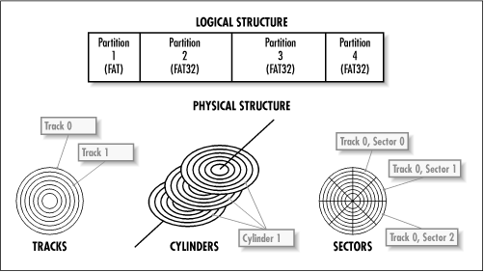
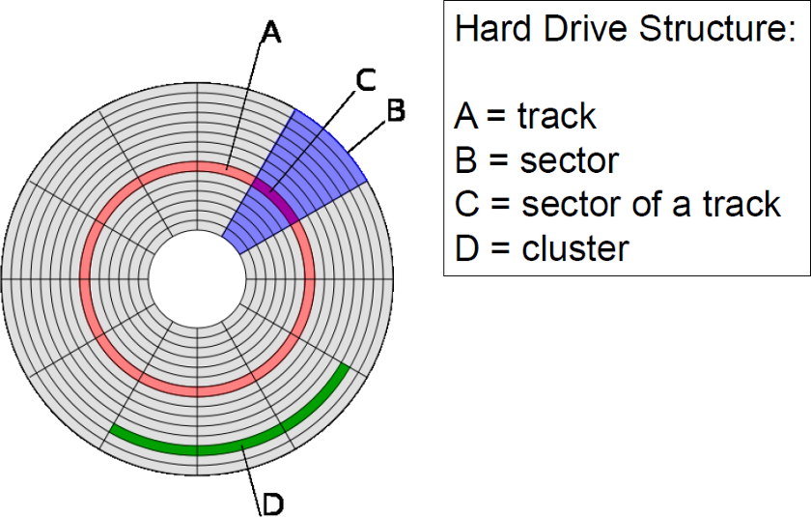
Sectors, Clusters and Volume ???????

Slide 37

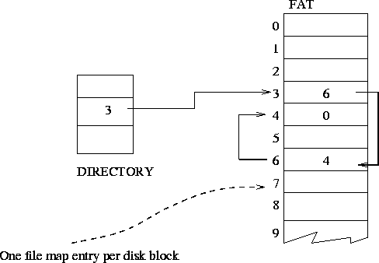
FAT Table
It contains pointers to every cluster on the disk.
It indicates the no. of the next cluster on the disk
It indicates the end of a cluster.
Tells whether a particular cluster is empty or not.

Slide 38

FAT Versions
FAT12: The earliest version the file system, FAT12 allows a partition to contain up to 4096MB/ (212)clusters.
FAT 16: oldest, created for DOS, supported by most OS’s, cannot be installed on partitions larger than 2 GB, or on hard drives larger than 4GB.
FAT 32: supports disks from 512MB to 2TB, compatible with Windows 98 and up
The FAT number refers to the
number of bits per table entry :
FAT12 -> 212 = 4M different clusters can
be addressed (used for floppy disks)
FAT16 -> 216 = 64M different clusters can be addressed (MS-DOS compatible)
FAT32 -> 228 = 256G different clusters (4 bits are reserved)

Slide 39

Problems in FAT
Updating the FAT table is very important as well as time consuming. If the FAT table is not regularly updated, it can lead to data loss. It is time consuming because the disk read heads must be repositioned to the drive's logical track zero each time the FAT table is updated.
There is no organization to the FAT directory structure, and files are given the first open location on the drive. In addition, FAT supports only read-only, hidden, system, and archive file attributes.

Slide 40

Problems in FAT
Fat file system was designed for disk of small size(up to few GBs), but later on the as the high capacity disks came into use, FAT file system could not support them.
FAT file system could not support the application required Recoverability, fault tolerance and file security.
Especially in corporate world, where recoverability and reliability was of great importance, FAT file system loose it ways to NTFS

Slide 41
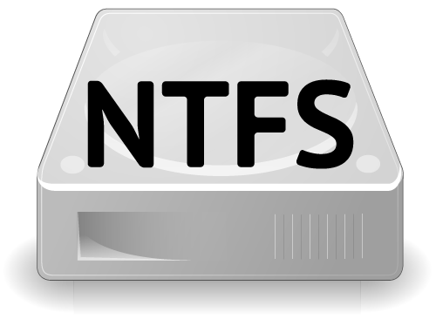
NTFS - New Technology File System
Developed by Microsoft and was included in Windows like XP, Vista ,2007 and 2008.
NTFS supersedes FAT and has many technical improvements which was missing in FAT.
It uses advanced data structures like B+ trees.
It is more reliable as compared to FAT.
Includes features like security, compression encryption, journaling, Indexing.

Slide 42

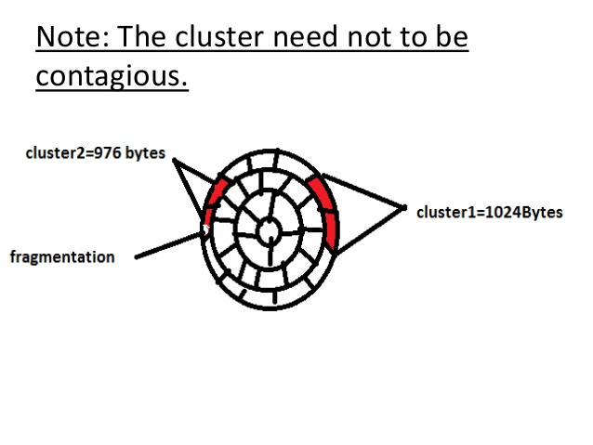
How Does NTFS stores data on disk ?
In NTFS every sector is of 512 bytes. Each cluster consist of 2 sectors.
Size of each cluster =2*512Bytes 1024 Bytes or 1KB.’
Let the size of the file = 2000Bytes.
So NTFS will allocate 2 clusters(or 4 sectors).
First cluster will store= 1024 Bytes.
Second cluster will store =976 Bytes
The cluster need not to be contiguous

Slide 43
NTFS : Table Layout
PARTIONING BOOT SECTOR | MASTER FILE TABLE | SYSTEM FILES | FILE AREA
Partioning Boot sector:
Contains the information about volume.
Size of each sector.
No. of sectors in each cluster and size of each sector.
Contains details about boot startup.
File Area: (analogous to Data Area in FAT)
This is the place where actual data is stored on the disk.
It spans across the remaining sectors of the disk.

Slide 44

Master File Table
Its is like an Index
Stores Information about every file and table which is stored in the volume on a disk.
There is at least one record for every file and directory.
It stores the details like , type, size, date/time of the creation of the file, date/time about the recent modification and author identity.

Slide 45
Master File Table Layout
STANDARD INFORMATION | FILE NAME | SECURITY DESCRIPTOR | DATA | EXTENDED ATTRIBUTES
Standard Information : Include access attributes such as read only, read/write etc.
File Name : A file or a directory must have a name.
Security descriptor : Specifies who owns the file and who else can access it.
Data : The actual content of the file.
Extended attributes : Any additional attributes that the author wants to define.

Slide 46

System Files
Log file-Tells about transaction steps used for NTFS recoverability.
Cluster bit map-Shows which clusters are free or in use.
Attribute Definition-Tells about the attribute types supported on a volume.

Slide 47

Advantages of NTFS over FAT
1. RECOVERABILITY:
In case of system crash or disk failure, it has the ability to reconstruct its volume and bring it to the consistent state.
Recoverability comes from the fact, that it uses TRANSACTION processing model.
Each operation is considered as atomic, either it is entirely completed or not at all.

Slide 48
Advantages of NTFS over FAT
2. AVAILABILITY: NTFS system maintains multiple copies of the critical files, so in event of the failure of a portion of a disk, files can be accessed from other location.
3. JOURNALING: NTFS keeps a log of all changes made to files on the volumes .

Slide 49
Advantages of NTFS over FAT
4. SECURITY: NTFS is more secure as compared to FAT in the sense that there is a security descriptor attribute, that defines the access rights and prevents unauthorized access to the file.
3. COMPRESSION & ENCRYPTION: Entire directory or any Individual file can be compressed and encrypted transparently.

Slide 50
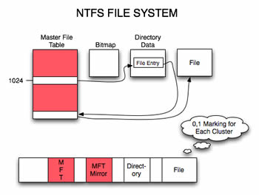
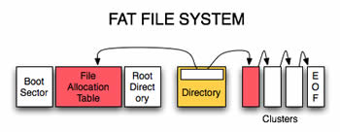

NTFS vs. FAT

Slide 51
 | NTFS | FAT
Security | It provides complete security to files and folders in the system. | There is no security of files and folders in the system.
Activity Log | In case of any failure, the files and folders can be easily restored. | In case of any failure, the files and folders are not recovered or restored.
File Compression | It supports flexible per file compression. | No such compression is supported.
File Size | It can be 4GB to 64 GB | It is 4GB Max
OS Compatibility | It only allows accessing on the recognized platforms, on a running computer. | It allows the accessing of files when the computer running on other or different platforms.
Data Sharing | It does not allow sharing data between the operating systems. | It allows sharing data between the operating systems.

Slide 52
OS and File System Compatibility
Operating System | FAT16 | FAT32 | NTFS
Windows XP | ✓ | ✓ | ✓
Windows 2000 | ✓ | ✓ | ✓
Windows NT | ✓ |  | ✓
Windows 98, ME | ✓ | ✓
Windows 95 | ✓
MS-DOS | ✓
Converting to NTFS :
In MS-DOS type command:
CONVERT drive: /FS:NTFS

Slide 53

Fat or Ntfs, But…………….
And Ntfs > Fat

